Slide 1
statistical processes for personalized medicine
Jeff Leek
Johns Hopkins Bloomberg Biostatistics

Slide 2
Anti-credits
Roger Peng
Kasper Hansen
Mark Segal
Ingo Ruczinski
Keith Baggerly
Adam Olshen
Anyone who has ever acknowledged me in a Banff talk.

Slide 3

share my talk!
You are free to:
Talk at: https://github.com/jtleek/talks
Provided:
Provided you attribute this work to its author and respect the rights and licenses associated with its components
Copy, share adapt and remix
Photograph, film and broadcast
Live tweet, blog, post video of
Adapted from: http://bit.ly/WUa0tx

Slide 4
demo (roger convinced me this would be a good idea) (btw how those legs feeling roger?)

Slide 5
take home messages
Creating gene signatures with tsps and fsva
Can/should we make this automatic?

Slide 6
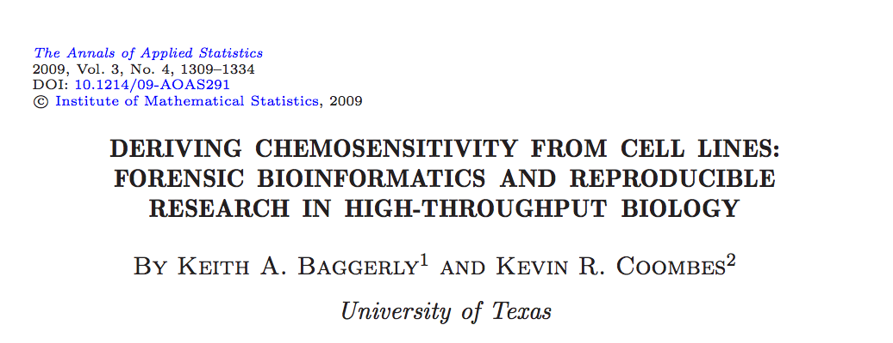
an example we all know

Slide 7
what were the problems?
irreproducibility
lack of cooperation
silly prediction rules
study design/batch effects
procedures not locked down
Transparency
Expertise

Slide 8
reproducibility

Slide 9
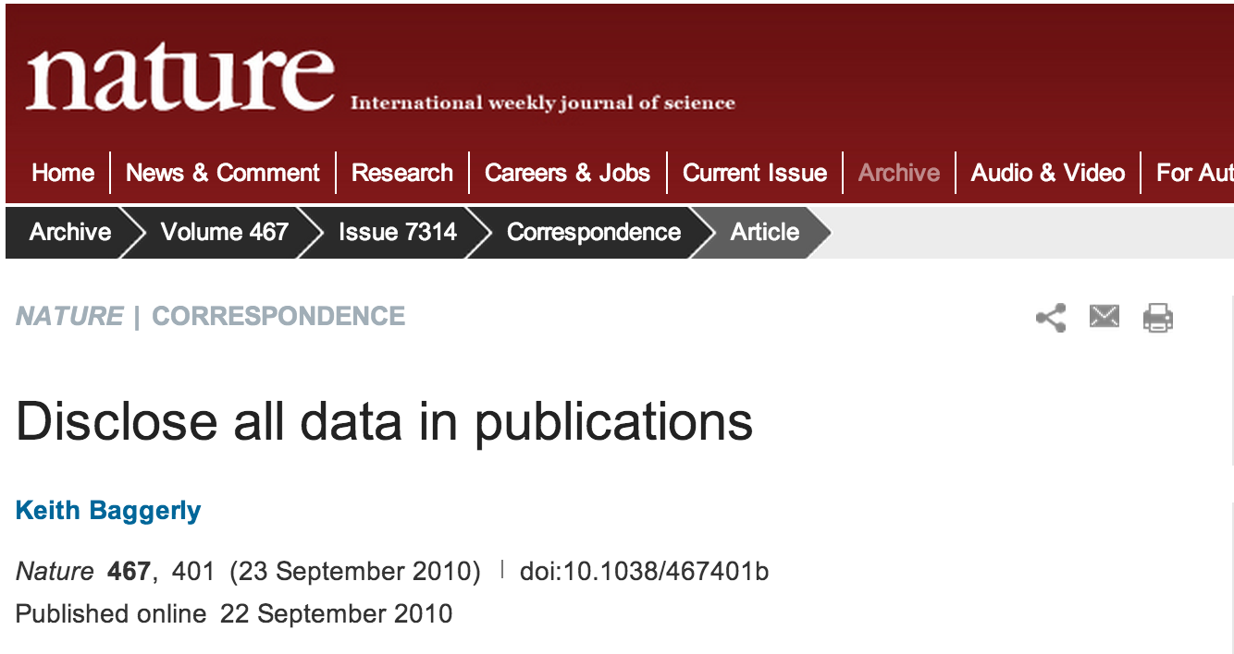
going the right direction

Slide 10
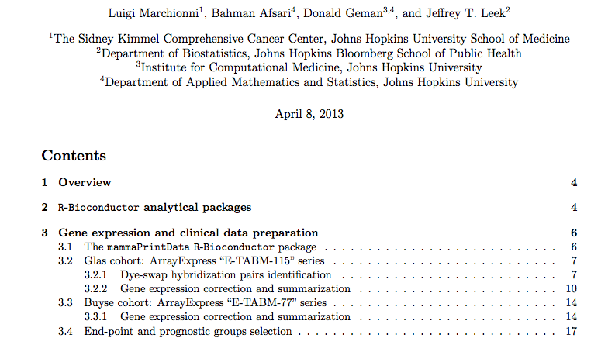
a reproducible research success story*
http://www.biomedcentral.com/content/supplementary/1471-2164-14-336-s1.pdf
http://astor.som.jhmi.edu/~marchion//breastTSP.html

Slide 11
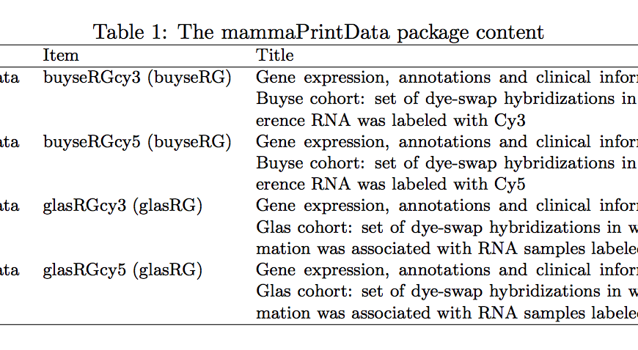
mammaprint data sets
http://astor.som.jhmi.edu/~marchion//breastTSP.html

Slide 12
transparency

Slide 13
*
Thank you for sharing the paper with us prior to publication. We discussed the publication internally and we feel that it is a very nice publication and would like you to proceed without uploading the excel file.

Slide 14
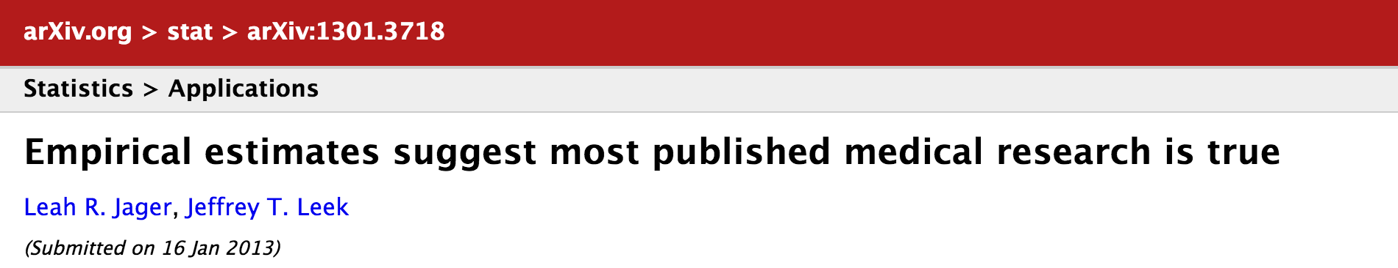
a digression
“However, the respective figure 3 panel (bottom I have compared several years/journals against what is shown in figure 3 panels and I get very different distributions. There is tons of things that are wrong with this paper, but at a minimum I would hope that the very basic numbers are correct.”

Slide 15
what were the problems?
irreproducibility
lack of cooperation
silly prediction rules
study design/batch effects
procedures not locked down
Transparency
Expertise

Slide 16
silly prediction rules

Slide 17
potti prediction rules
P(FTAC) = P(T) + P(F) + P(A) + P(C) – P(T)P(F)P(A)P(C)
P(ET) = max[P(E),P(T)]
P(FEC) = 5/8[P(F) + P(E) + P(C)] – 1/4
Baggerly et al. AOAS 2009

Slide 18
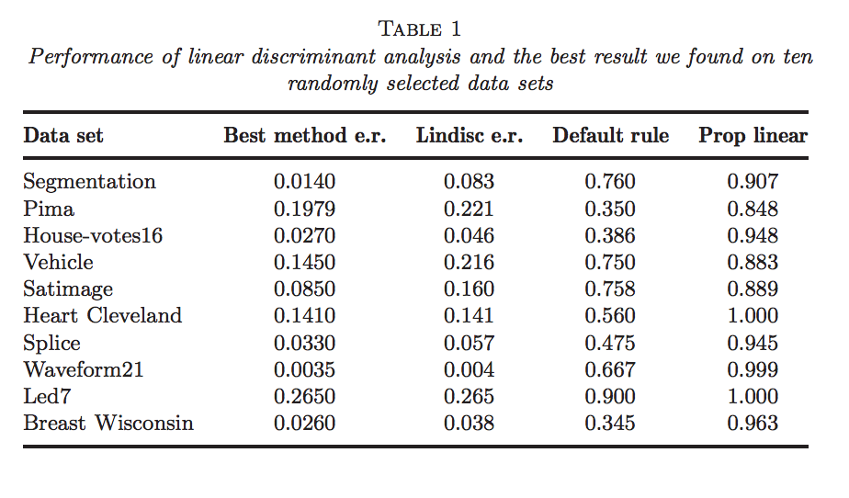
illusion of progress in ml
Hand Statistical Science 2006

Slide 19
one stupidly simple predictor
Leek Bioinformatics 2009

Slide 20
comparably accurate
Adapted from Geman et al. SAGMB 2004

Slide 21
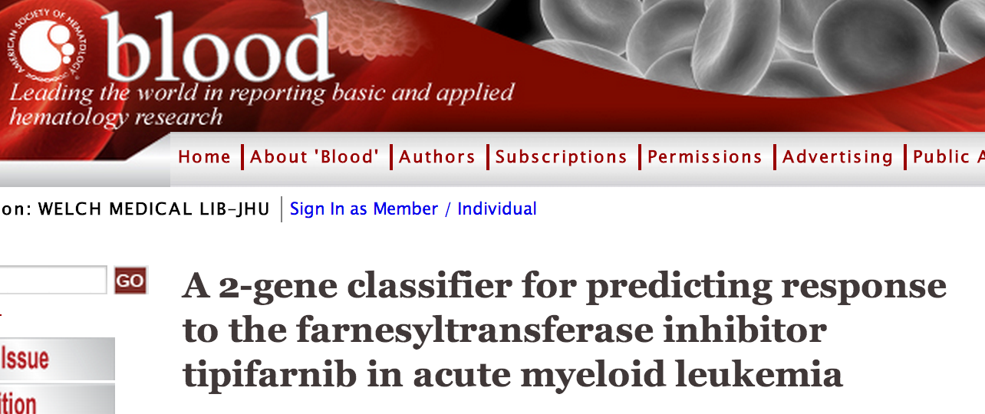
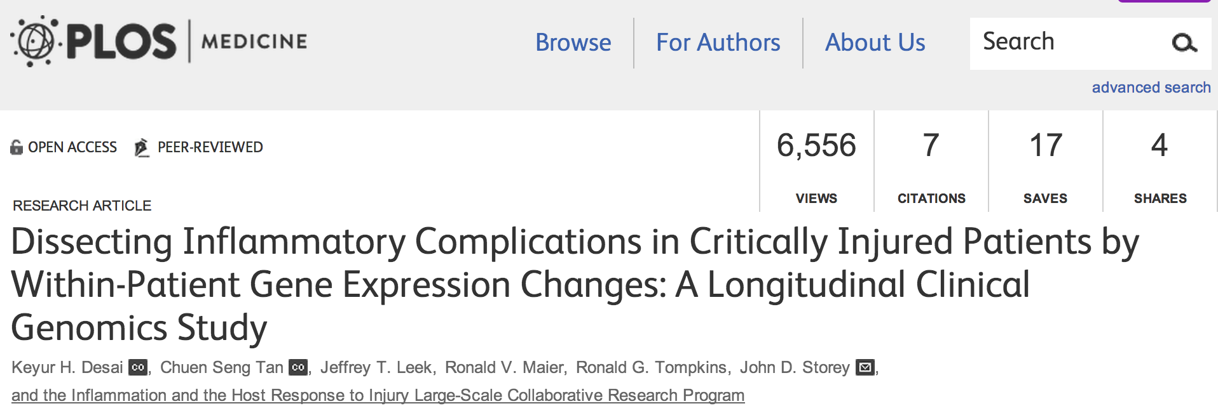
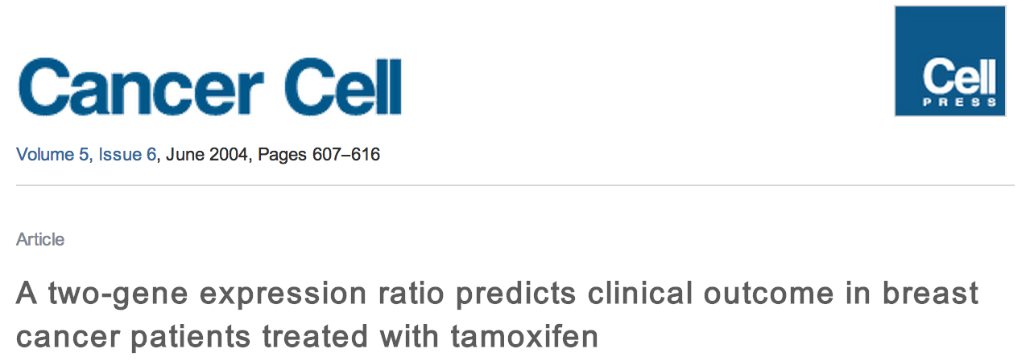
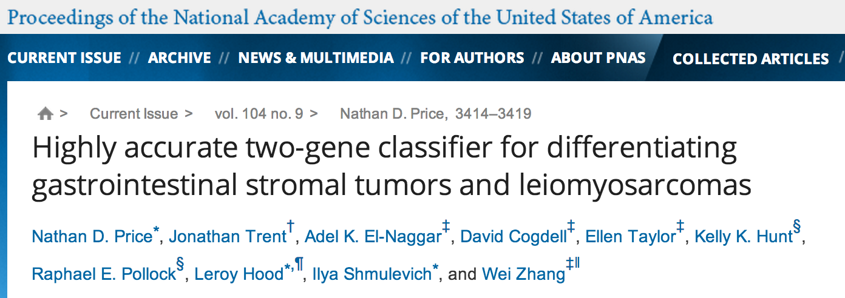
some success

Slide 22
top scoring pairs
Data:
x_{ik} - value for feature i, sample k
y_{k} - group indicator for sample k
TSP is (i,j) pair that maximizes:
⌃
⌃
|Pr(x_{ik} < x_{jk} | y_{k}=1) – Pr(x_{ik} < x_{jk} | y_{k}=0)|
Geman et al. SAGMB 2004

Slide 23
regression framework
z_{ijk}=1(x_{ik} < x_{jk})
E[z_{ijk}|y_{k}] = a_{0ij} + a_{1ij}y_{k}
→ max |a_{1jk}| = TSP
Patil et al. in prep

Slide 24
flip the regression
Not the same as TSP
But |â/s.e.(â)| = |û/s.e.(û)|, algebraically
“Variance regularized” TSP
z_{ijk} invariant to monotone transformations
Fix parameters → find features
E[y_{k}|z_{ijk}] = u_{0ij} + u_{1ij}z_{ijk}
Patil et al. in prep

Slide 25
tsp-regression algorithm
Calculate t-statistic for all pairs
Choose top k pairs
Score for sample i is ∑sign(u_{1ij})z_{ijk} for pairs
E[y_{k}|z_{ijk}] = u_{0ij} + u_{1ij}z_{ijk}
Patil et al. in prep

Slide 26
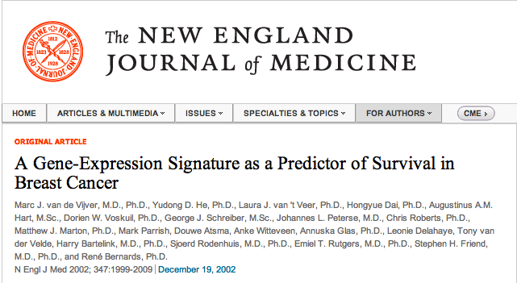

a very successful genomic signature

Slide 27
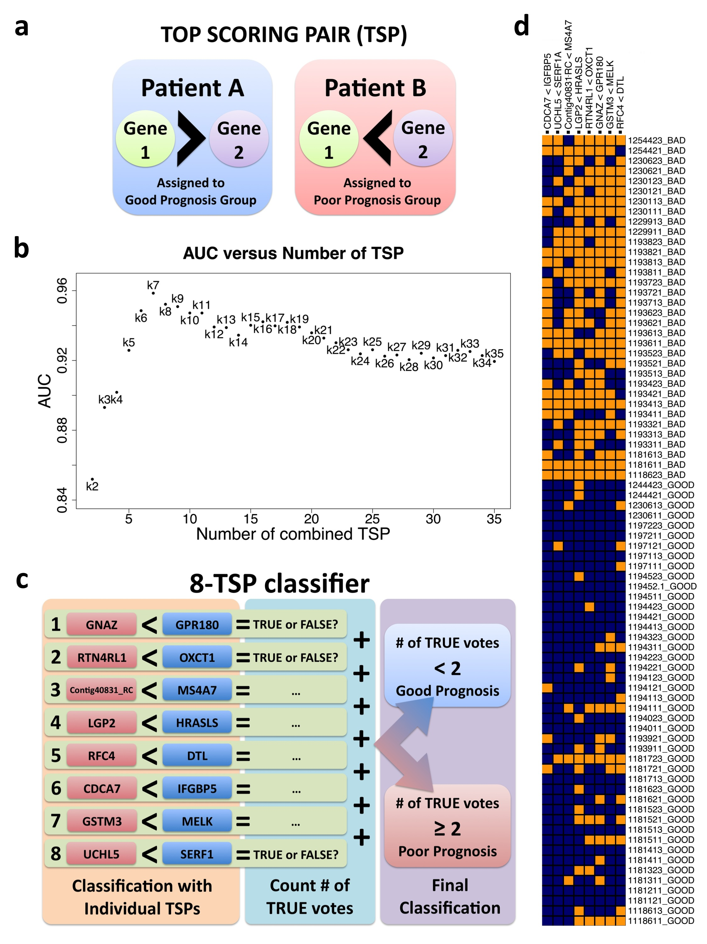
mammaprint alternative
Marchionni et al. BMC Genomics 2013

Slide 28
survival tsp
Cox regression
Pick max log hazard ratio |û/s.e.(û)|
Alternatives – max logrank, etc.
h(t|z_{ijk}) =h_{o}(t) exp(u_{0ij} + u_{1ij}z_{ijk})
Patil et al. in prep

Slide 29
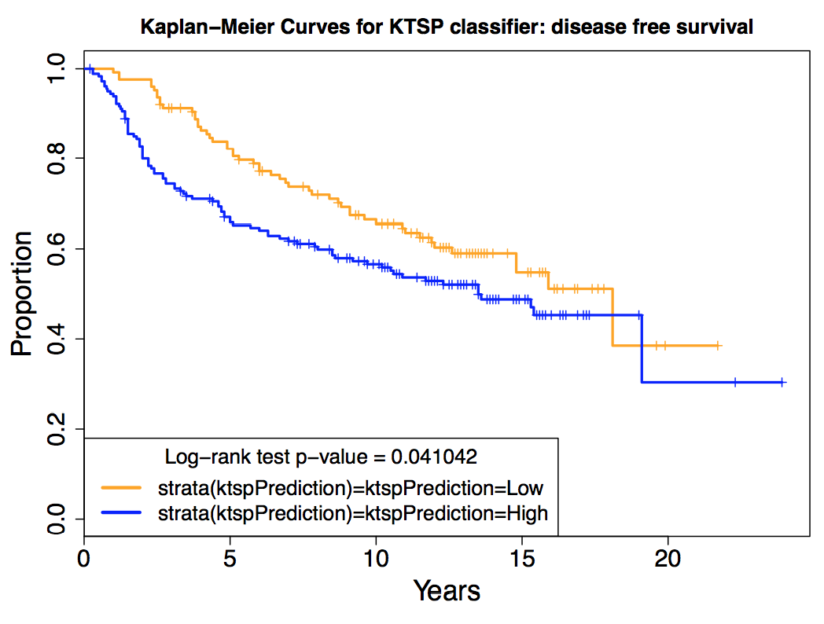
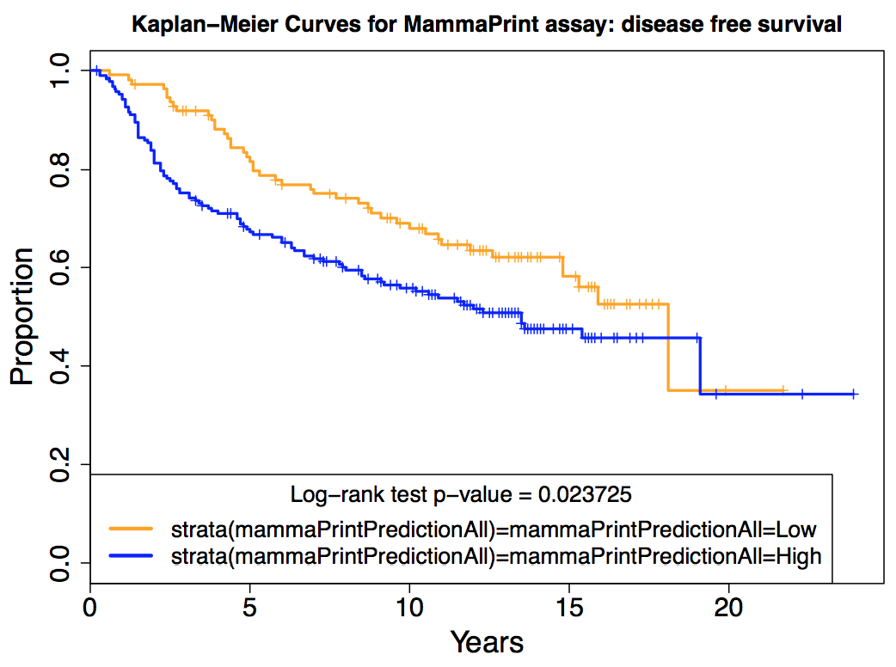
survival comparison
ktsp
mammaprint
Marchionni et al. BMC Genomics 2013

Slide 30
batch effects

Slide 31

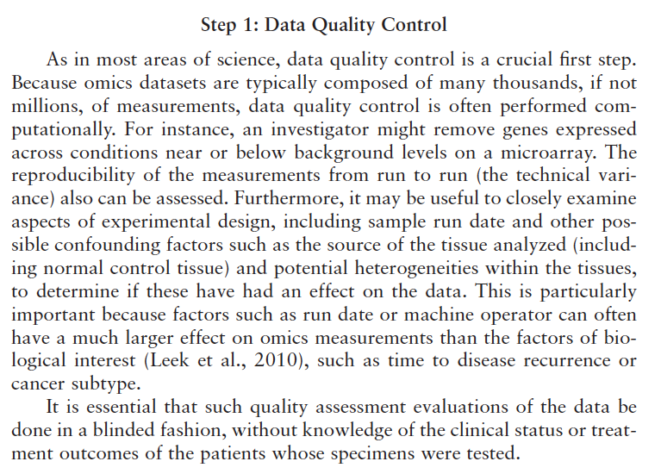
iom report

Slide 32
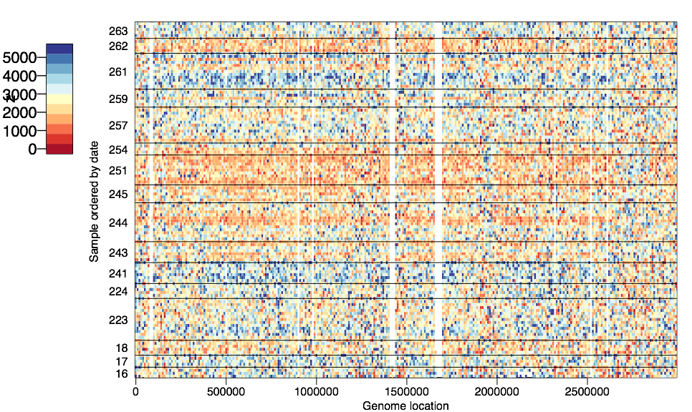
1000 genomes exome coverage (quantile normalized)
Leek et al. Nat. Rev. Genetics 2010

Slide 33
batch effects
Higher coverage on certain days, even after normalization
Leek et al. Nat. Rev. Genetics 2010

Slide 34
what can happen

Slide 35
what can happen

Slide 36
surrogate variable analysis
We observe
samples
Group
Batch
Error
=
+
+
genes/transcripts/probes

Slide 37
surrogate variable analysis
We want to estimate
samples
Group
Batch
Error
=
+
+
genes/transcripts/probes

Slide 38
surrogate variable analysis
samples
Group
Batch
Error
=
+
+
genes/transcripts/probes
We need to find this part of the matrix

Slide 39
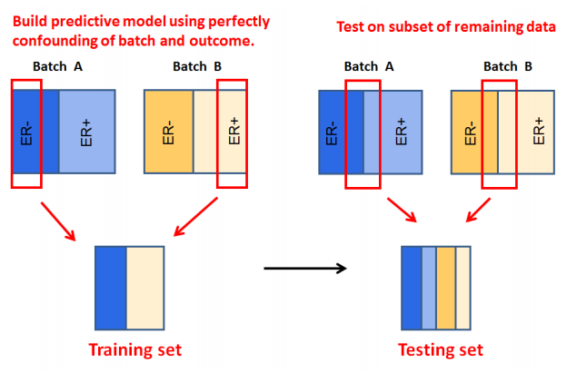
batch affects prediction
Parker and Leek SAGMB 2012

Slide 40
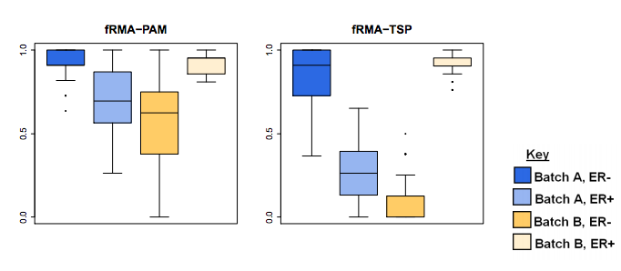
batch affects prediction
Parker and Leek SAGMB 2012

Slide 41
procedure lockdown

Slide 42
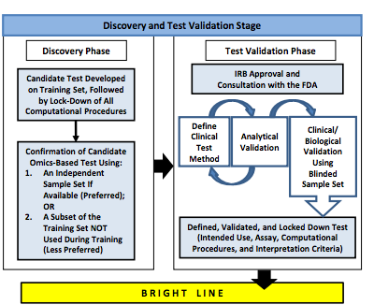
locking down procedures

Slide 43
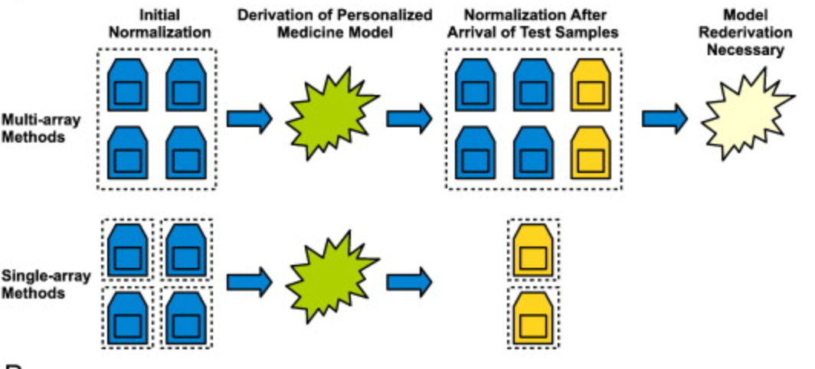
“freezing” preprocessing
Piccolo et al. Genomics 2013

Slide 44

example
Case: 50
Case: 50 + 1
Case: 50 + 5

Slide 45
preprocess all together
Case: 50
Case: 50 + 1
Case: 50 + 5

Slide 46
d.e. on only first 50
Case: 50
Case: 50 + 1
Case: 50 + 5

Slide 47
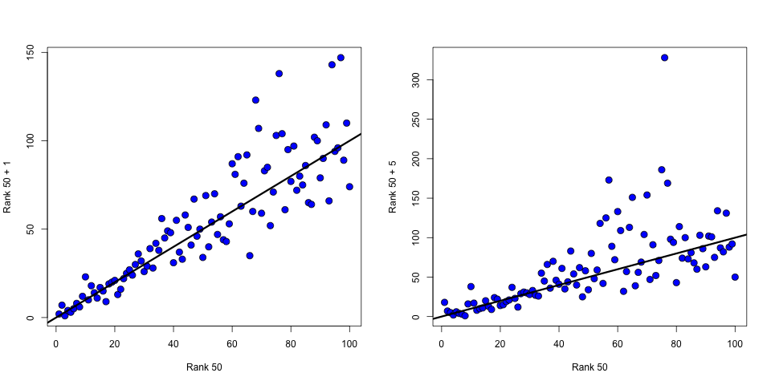
ranks of de genes

Slide 48
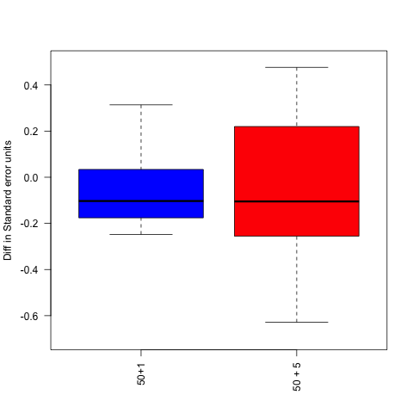
change in top 100 coefficients
(coeff50 – coeff50+1)/s.e.(coeff50)

Slide 49
most batch corrections are population level
samples
Johnson et al. 2007, Walker et al. 2008, Scharpf et al. 2010, Leek and Storey 2007, 2008, Kang et al. 2008, Friguet et al. 2010, Stegle et al. 2010, Gagnon-Bartsch and Speed 2011, Sun et al. 2011, Jacob et al. 2012, Mostavi et al. 2013 …
Batch
Group
Genomics
Data

Slide 50
clinical applications – building a classifier
samples
Batch
?
Group
?
Genomics
Data
Single
Genomic
Sample
Parker and Leek Submitted

Slide 51
clinical applications –applying a classifier
samples
Batch
?
Group
?
Genomics
Data
Single
Genomic
Sample
Parker and Leek Submitted

Slide 52
frozen surrogate variable analysis
Step 1 Estimate weights, batch, and batch coefficients from the training set or another suitable database using
population level sva.
sva
Parker and Leek Submitted

Slide 53
frozen surrogate variable analysis
Step 2 Regress batch effects from the genomic data.
−
=
Parker and Leek Submitted

Slide 54
frozen surrogate variable analysis
Step 3 Build a predictor
on the clean data
Your favorite prediction algorithm
Parker and Leek Submitted

Slide 55
frozen surrogate variable analysis
Step 4 Append the new sample to the database. Weight by the probability
weights from sva and estimate batch for the new sample.
×
=
SVD of combined matrix
Parker and Leek Submitted

Slide 56
frozen surrogate variable analysis
Step 5 Apply the
coefficients estimated
from the database, subtract the batch effect,
and apply the classifier.
-
=
Parker and Leek Submitted

Slide 57
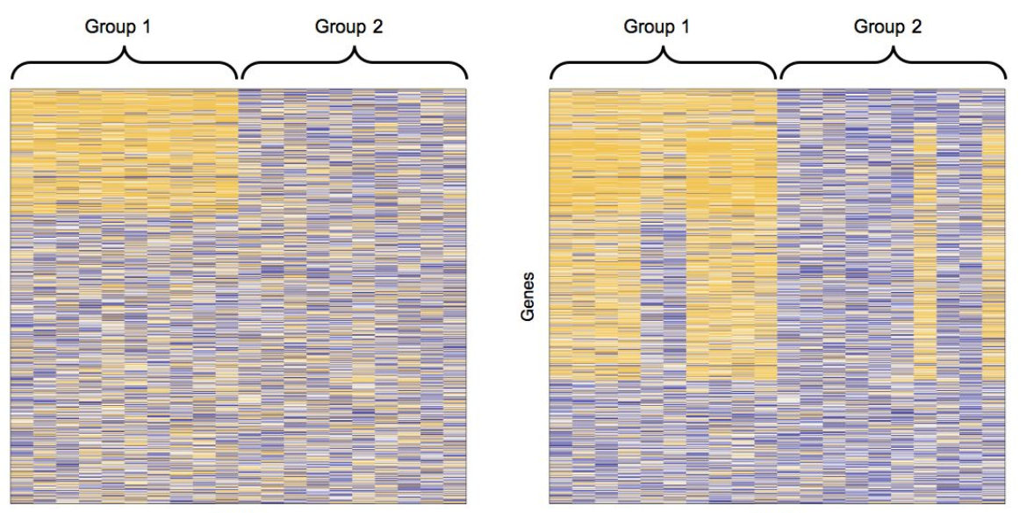
simulated example
No Batch
Batch
Genes
Genes
Arrays
Arrays
Parker and Leek Submitted

Slide 58
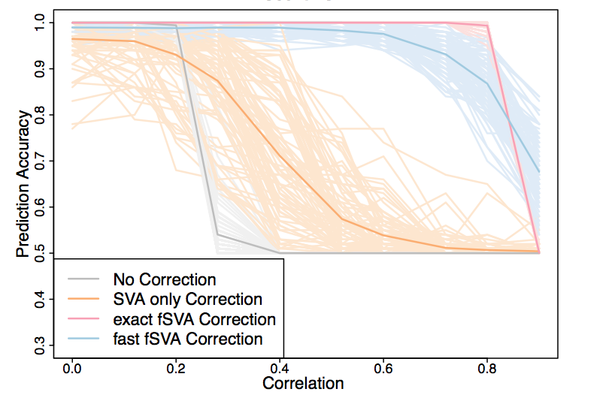
results
Parker and Leek Submitted

Slide 59
should we automate this?

Slide 60
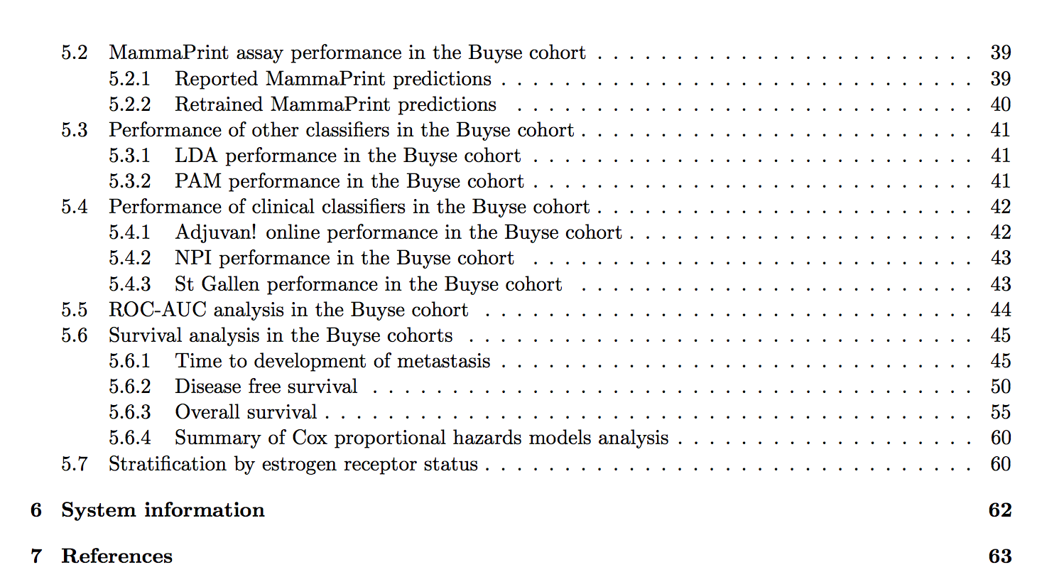
should we automate all this?
Supplement to Marchionni et al. BMC Genomics 2013

Slide 61
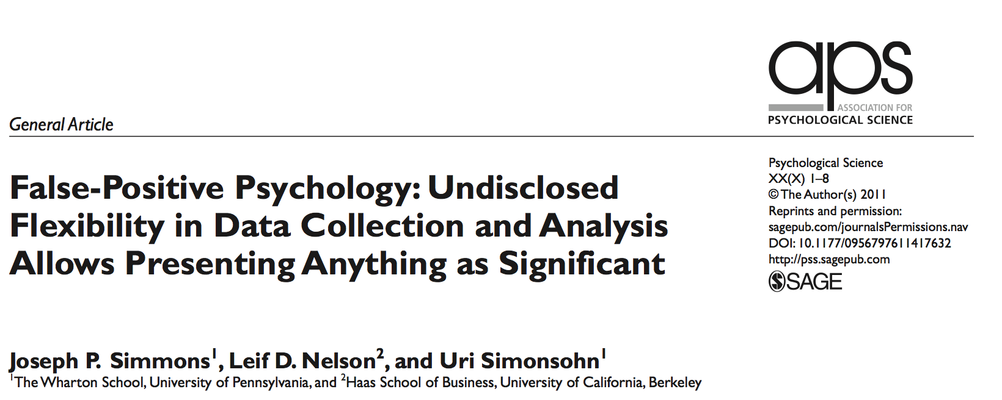
“hacking” statistics

Slide 62
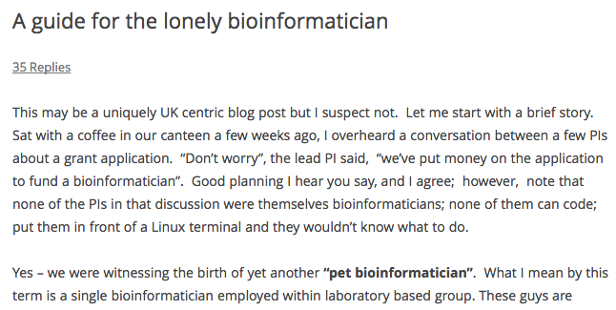
the lonely bioinformatician
http://bit.ly/10vS1yt

Slide 63
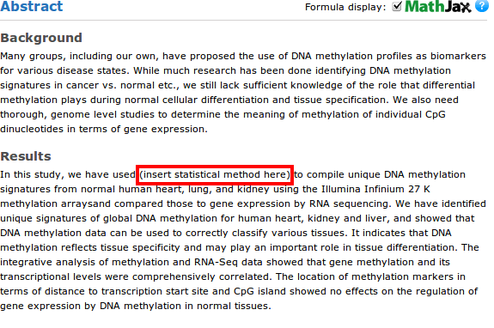
what can easily happen
http://bit.ly/OgW3xv

Slide 64
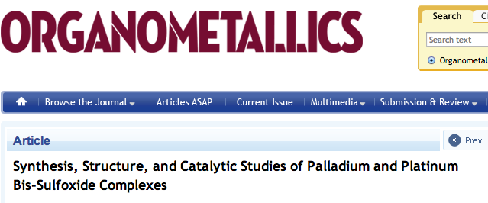
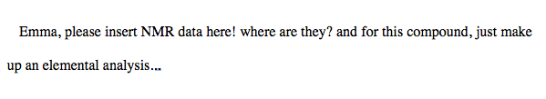
what can easily happen
Drinkel et al. Oganometalics 2013

Slide 65
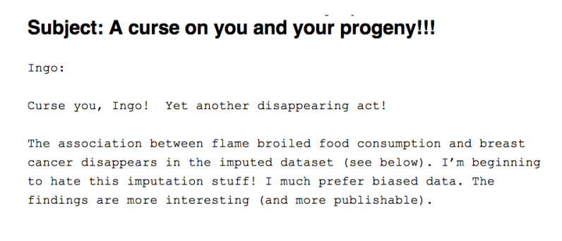
what can easily happen

Slide 66
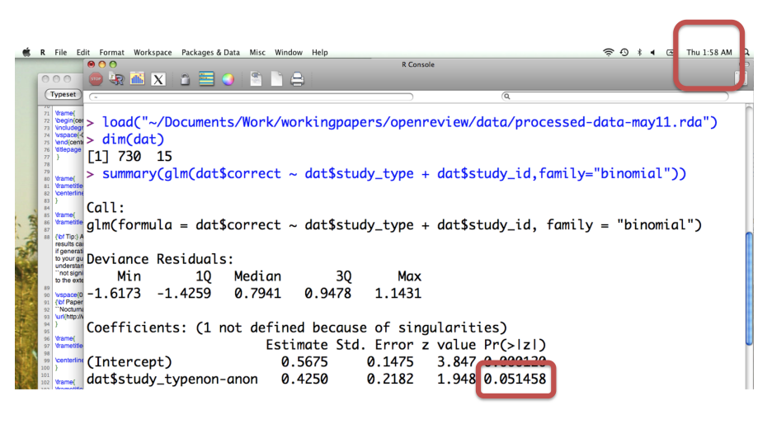
why I’m sympathetic

Slide 67
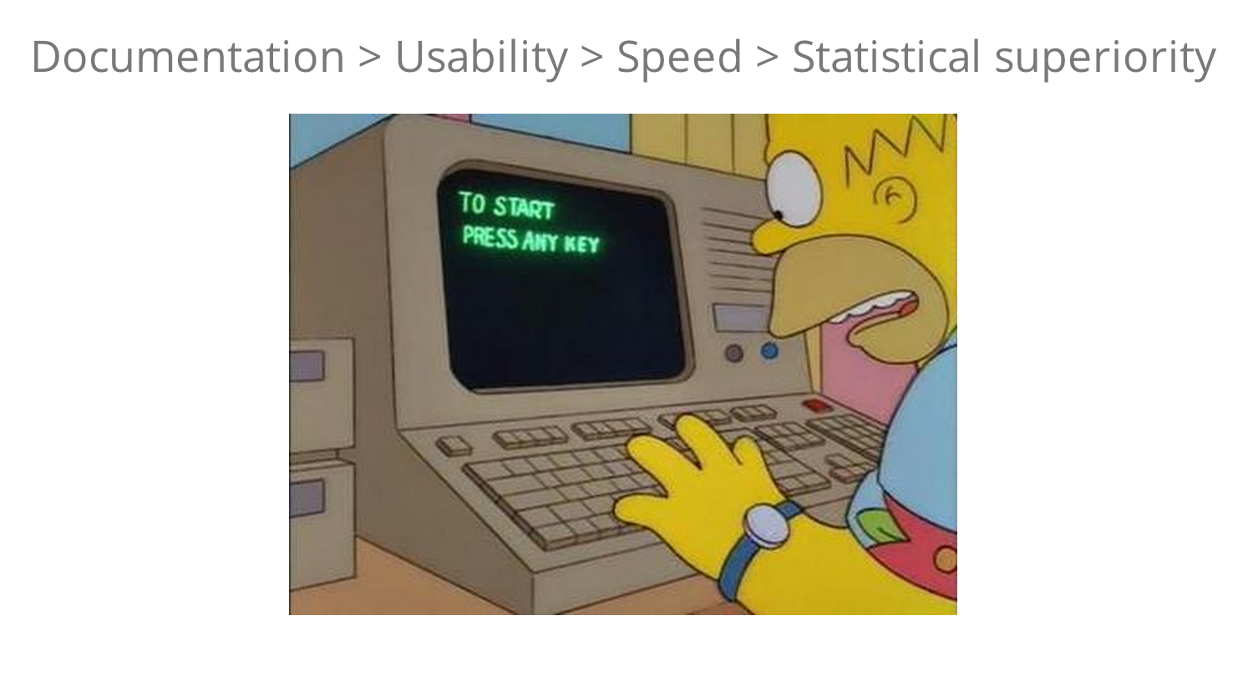
if you want your software used
http://bit.ly/17pGTRN

Slide 68
a deterministic statistical machine for signature development
Inputs
Discovery CEL file directory
Discovery META file
Must have variables: outcome, CEL names, (survival time)
Validation CEL file directory
Validation META file
Must have variables: outcome, CEL names, (survival time)
Outputs
R markdown file
HTML report
Locked down function
Interactive personalized website

Slide 69
steps in the machine
Load the data
Preprocess gene expression
Merge the phenotype + expression
Get batch information
Check for study design problems
Perform fsva
Split training data set into discovery/test
Build predictor on discovery, try on test
Pick number of pairs based on test
Apply to validation data
Create and save predictive function
Create and save interactive visualization

Slide 70
a partial list of issues
Batch – listed or scanned
Normalization – platform dependent
Rawfiles – naming convention
Merging – filenames
Naming survival variables
Subsetting to which population?
….

Slide 71
back to our demo

Slide 72
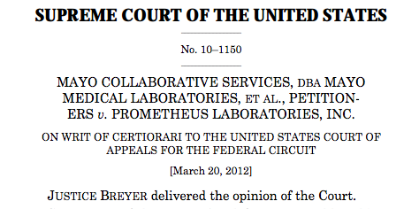
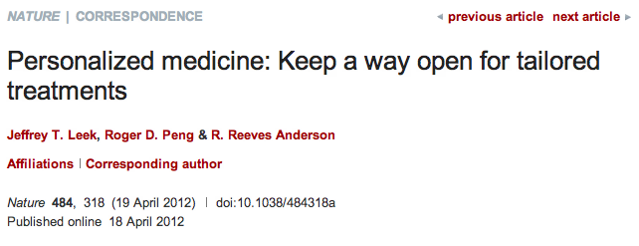
why make it open?
http://simplystatistics.tumblr.com/post/19646774024/laws-of-nature-and-the-law-of-patents-supreme-court

Slide 73
get it while its hot
sva:
https://github.com/jtleek/sva
tspreg:
https://github.com/jtleek/tspreg
rdsmGeneSig:
https://github.com/jtleek/rdsmGeneSig
healthvis:
http://healthvis.org/

Slide 74
acknowledgements
Hopkins
Roger Peng
Ben Langmead
Sarven Sabunicyan
Luigi Marchionni
Donald Geman
Funding
Amazon Web Services
Digital Science
NIH
CCNE
Hopkins inHealth
Leek Group
Hilary Parker (alum)
Alyssa Frazee
Prasad Patil
Leo Collado Torres
University of Maryland
Héctor Corrada Bravo
Harvard
Rafael Irizarry
Lieber Institute
Andrew Jaffe

